Slide 1



SAPUI5: Application Structure
Customer

Slide 2
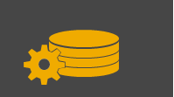
Agenda – SAPUI5
SAPUI5
Model-View-Controller
Anatomy of an Application

Slide 3
SAPUI5

Slide 4


SAPUI5 / OpenUI5
SAP UI5 is a toolkit for developing client applications on both mobile and desktop platforms
Based on JavaScript and JQuery, SAPUI5 is a HTML5 rendering engine with a large library of simple and complex controls
It supports the Model-View-Controller concept and declarative UI construction
OpenUI5 is an open source version freely available under the Apache 2.0 Open Source license

Slide 5
Model-View-Controller

Slide 6
Model-View-Controller
The MVC programming paradigm divides a program into three parts in order to separate the representation of data from the presentation of the data.
The Model manages the data and connections to data sources, notifying the View and Controller when data has changed.
The View creates the user interface. Views are bounded to Models and represent the data for the user.
The Controller contains the control logic and manages the interaction between the View and the Model.
By separating the user interface from the data and logic, the MVC paradigm produces applications that are easier to create and to maintain. For example, it’s relatively easy to create a new user interface for a MVC app since it is a separate component.

Slide 7
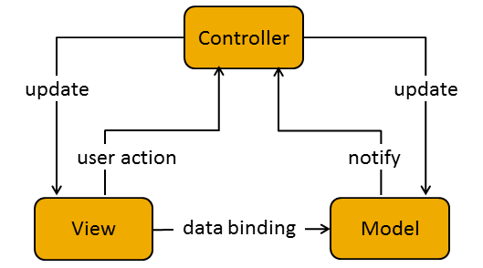
Model-View-Controller

Slide 8
The Model
Models are used to manage application data. Currently SAPUI5 supports data in XML, JSON and OData format and you can create your own implementation if necessary.
This line of code creates an OData based model. Because the URI is the service document, all the services defined in that document including associations will be available to the application.
var oModel = new sap.ui.model.odata.ODataModel(<URI to Service Document>);
More than one model can be created in an application if necessary by giving them names.

Slide 9
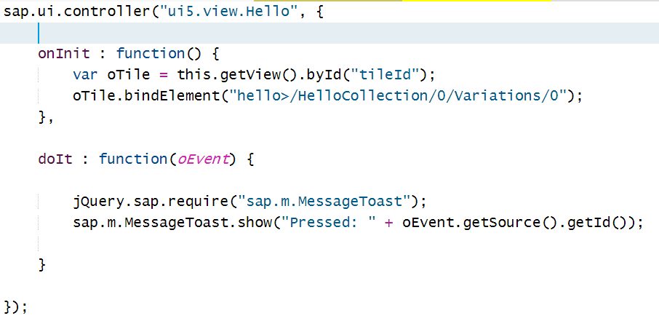
The Controller
Controllers are associated with views. The controller contains several lifecycle functions such as the onInit() function which is called when the view is first instantiated. In addition, you can add your own functions such as event handlers for the controls in the view.

Slide 10
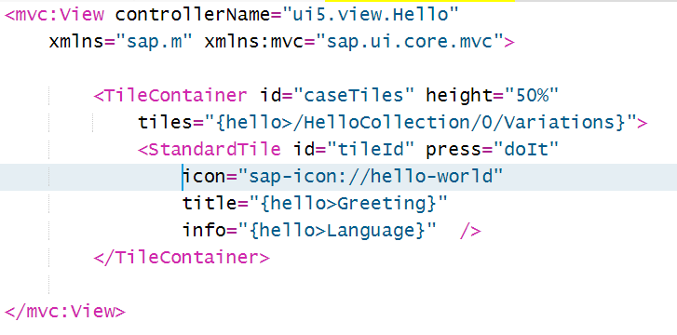
The View
Views are used to create the visual interface. Views can be fined using JavaScript, HTML, JSON and XML. SAP currently recommends the use of XML because it emphasizes the separation of interface and procedural logic and work with the new WYSIWYG Layout Editor.

Slide 11
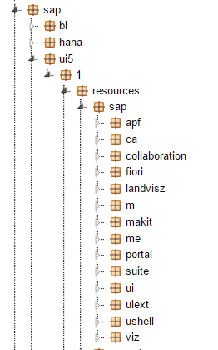
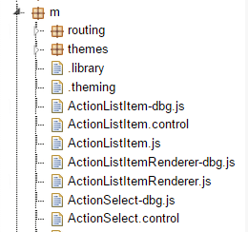
SAPUI5 Namespaces
SAPUI5 consists of a large number of libraries which are referenced using namespaces. The image to the right shows the packages that contain the SAPUI5 libraries on a HANA system. The namespace sap.m refers to the m package located in the sap package.
The namespace contains the actual implementations of SAPUI5 controls in JavaScript files.

Slide 12
Anatomy of a XML View
The view is contained within <mvc:View> and </mvc:View> tags. In the opening tag the controller associated with the view is defined.
Note the use of the ui5 namespace that was created in the index.html file.
Any namespaces required for the view are also identified. The fact that xmlns=“sap.m” does not include a shortcut (identified by the colon) means it is the default namespace for the view.
xmlns:mvc=“sap.ui.core.mvc” defines mvc as a shortcut for the sap.ui.core.mvc namespace. This shortcut is used in the <mvc:View> tag so that SAPUI5 will know to find the library for the View control in the sap.ui.core.mvc namespace.
The controls in the file follow the same structure as on the visual interface.

Slide 13
Controls
Controls are the building blocks of the user interface:
Simple controls such as Label, Button, TextView
Value holders are controls that contain values such as Combo boxes and ListBoxes as well as controls which allow uses to make choices such as CheckBoxes
Layout controls are used to arrange the elements of the interface
Complex controls allow the embedding of other controls. An example is the table control used in the Sales app. In a table the columns are made up of other types of controls such as TextFields used in the Sales app
Dialogs are used to create dialog boxes

Slide 14
Data Binding
Once the model is defined, it can be bound to controls. SAPUI5 supports two-way binding which means that changes in the data will automatically be reflected in the bound controls and changes to data on the interface will automatically be made in the model data. There are two types of binding:
Aggregation bindings are used when multiple items in a data set are bound to a control. This is used, for example, with List or Table controls.
Property bindings which bind an individual data item to a control. Used for example with individual items on a List control or a Label control.
Aggregation binding
Property binding

Slide 15
Anatomy of an Application

Slide 16
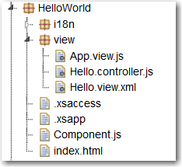
Anatomy of An Application
One of the strengths of SAPUI5 is that there are many ways to do most things. Unfortunately, this can make the learning curve much more difficult because there doesn’t seem to be any consistency between examples.
In this curriculum a consistent application structure is used, chosen because it seems to be an emerging standard approach.
The application shown here is the MVC Hello World application described in case HD1C01. It shows the basic elements of an application: index.html, component.js, views and controllers.

Slide 17
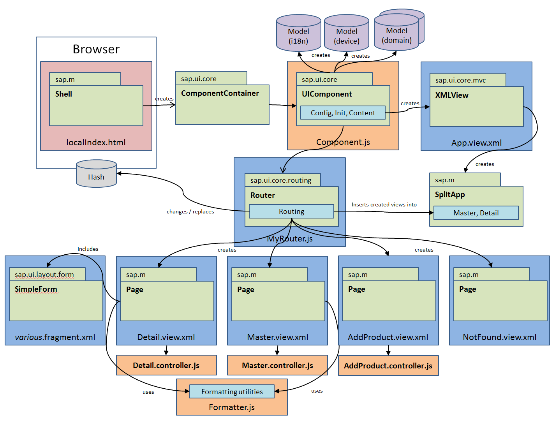
Application Architecture
Component defines metadata for the application, defines models, creates the router object which handles navigation and loads App view.
Index.html file bootstraps UI5 libraries and loads the component
App view creates the application object which defines the interface structure: full screen or master/data
Router object handles navigation between views
Views make up the visual interface
Controllers assigned to views, handle logic

Slide 18
The index.html file
The index.html file bootstraps the application and provides an HTML element that will be the container for the HTML code generated by SAPUI5. It consists of two main sections:
The first section, called the bootstrap, loads the core SAPUI5 library, loads a theme and defines namespaces.
The second section creates the initial component which encapsulates the application.

Slide 19
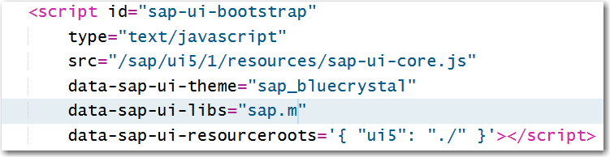
Bootstrapping
The code below loads the sap-ui-core library which contains the core SAPUI5 libraries as well as jQuery. It then loads the sap.m namespace which contains common controls such as buttons and labels.
The last line defines the namespace for the application. Normally, SAPUI5 will look for application files relative to the location of the sap-ui-core.js file so we must define a namespace with which we can refer to application files that is relative to the root folder of the application.

Slide 20
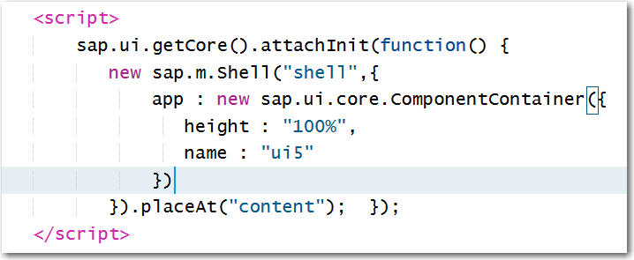
Creating the Initial Component
A component is a self-contained unit of an application. Components can be loaded dynamically by an application and can be used to encapsulate reusable functionality. For example, if a table of customers is used in multiple applications, it can be encapsulated in a component and reused. Current practice is to use a component to encapsulate an entire application. The code below in the index.html file creates a component and, in this case, encloses it in a Shell control which can provide interface elements such as a header.
The component is inserted into the application’s HTML using the placeAt method.

Slide 21
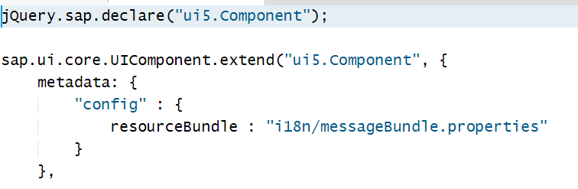
The Component.js file
The name of the Component.js file is required. The file consists of at three sections:
The metadata for the component is defined. This may include addresses of data sources, information about navigation among the views of the application, etc.
A init() function that initializes the component.
A createContent() function that creates the initial view of the application.

Slide 22
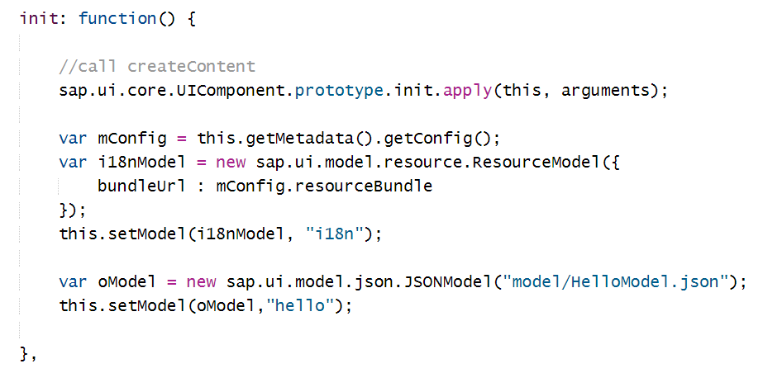
The Component.js file
The init() function initializes the component and can then define models that will be available to the entire application.

Slide 23
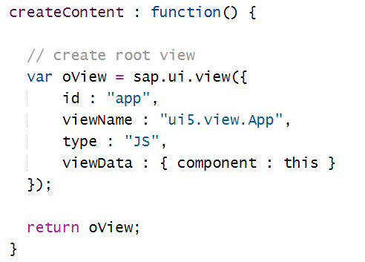
The Component.js file
The createContent() function loads the App view which is the root view of the application.

Slide 24
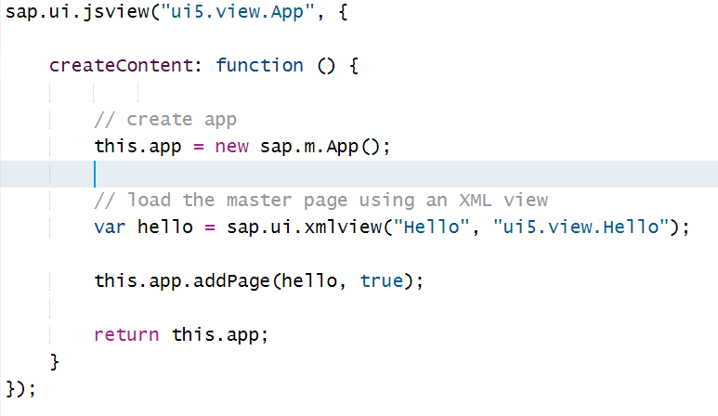
The App view
The App view doesn’t have a visual component but services as the root view for the application.
It defines the application object which, among other things, defines the basic structure of the
application (full screen vs. master/detail).
In simple applications, it may load the initial visible view.
Note the use of the ui5 namespace defined in the index.html file. SAPUI5 will look in the view folder located in the projects root folder to find the App.view.js file.

Slide 25
Helpful Links
SAPUI5 Developer Center
http://scn.sap.com/community/developer-center/front-end
Documentation and Demo Kit
https://sapui5.hana.ondemand.com/sdk/#content/Overview.html
Install SAPUI5
https://tools.hana.ondemand.com/#sapui5
Install OpenUI5
http://sap.github.io/openui5/index.html

